Slide 1

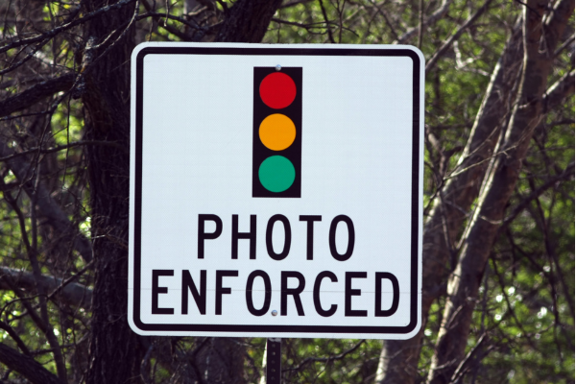
Automated Traffic
Enforcement Safety Devices in Connecticut

Slide 2

What is the
T2 Center?
Local Technical Assistance Program
Safety Circuit Rider
Traffic Signal Circuit Rider
Notes:
Housed at UCONN College of Engineering’s CT Transportation Institute
3 programs working together to support local agencies.
Partner with CTDOT, FHWA, COGs, others

Slide 3




Safety Circuit Rider Team
Shawn Barry– Safety Technical Associate
Jason Hughes – Safety Technical Associate
Lisa Knight – Educational Program Coordinator

Slide 4
ATESD: The Basics
Violation of a Town Ordinance vs Violation of a State Statute
Minimum of 10 mph Over the Speed Limit
At Least Two Signs Must Accompany Each Camera
Ticket is Mailed to Registered Owner of the Vehicle within 30 days
The Focus is Traffic Safety – Reduce Crashes, Injuries and Fatalities
Once Equipment is Deployed, 30 Days of Warnings

Slide 5
ATESD: The Basics
First Offense - $50 + $15 Maximum Admin Fee That Vendor Keeps
-Second and Subsequent Offenses - $75 + $15 Admin Fee
-Police Fines for 11 mph over are $151 or $207 in a School Zone
Each Ticket is Reviewed By Vendor and ANY Municipal Employee
No Points Against License
No Reporting to Insurance Companies
There is an Appeal Process

Slide 6

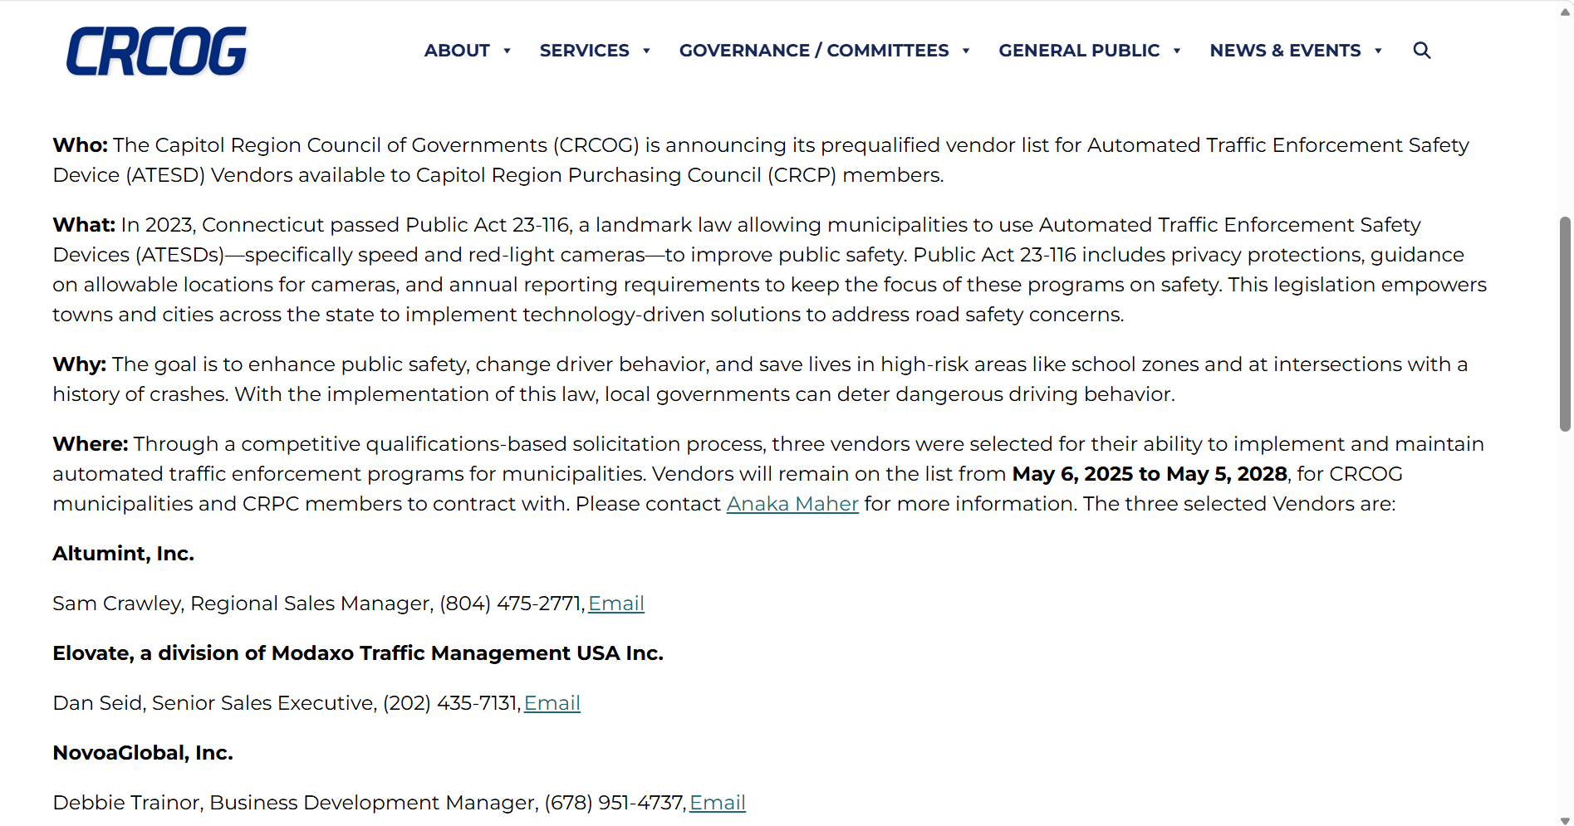
Talk
To
A
Vendor

Slide 7
The
Application
Process

Slide 8
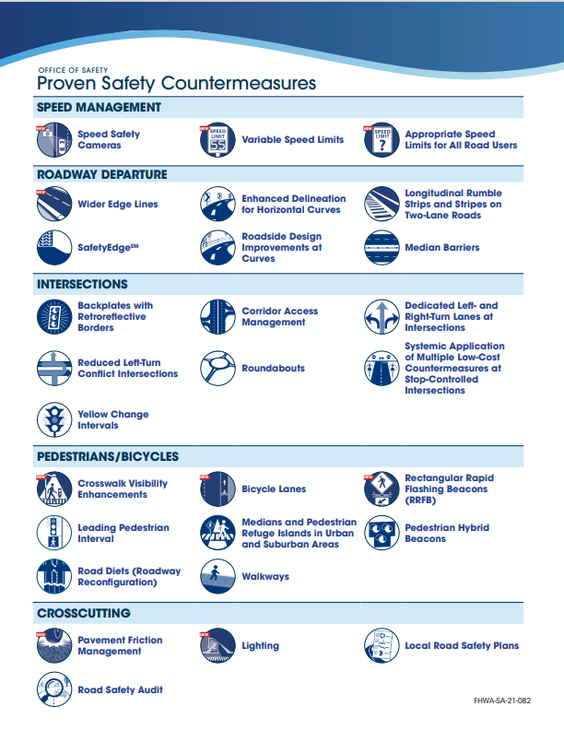
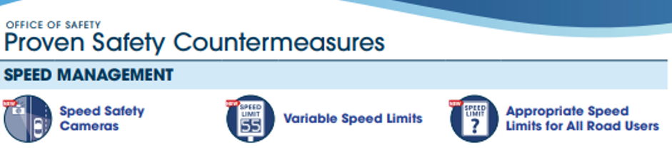
Speed Cameras are No Longer a Proven Safety Countermeasure

Slide 9

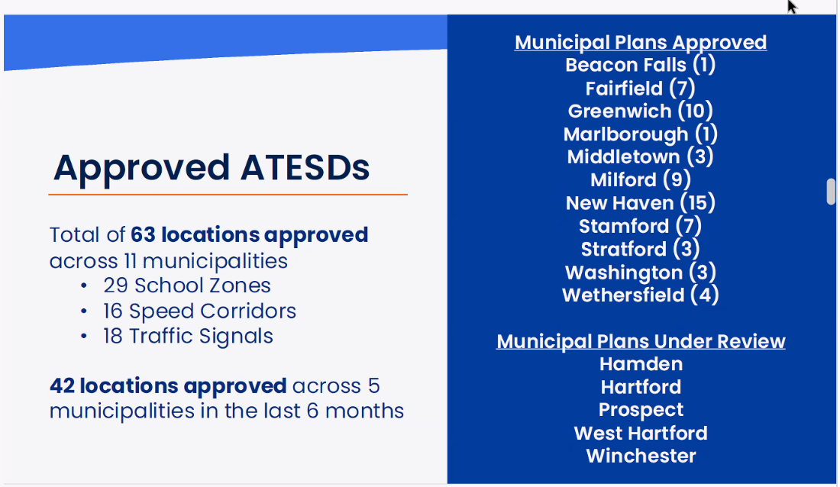

Slide 10

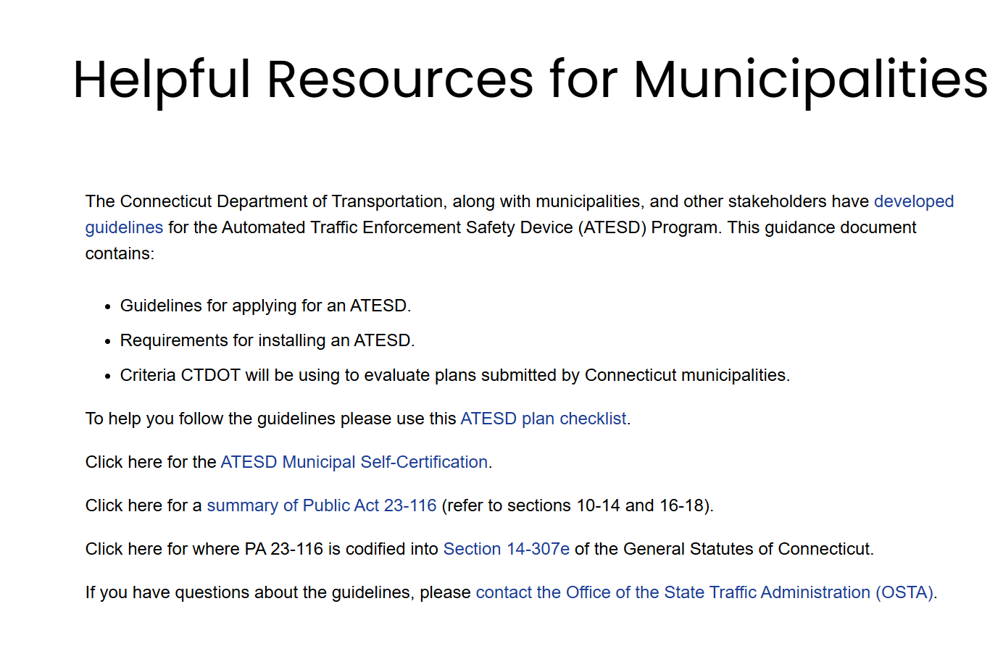
On the DOT OSTA Website

Slide 11
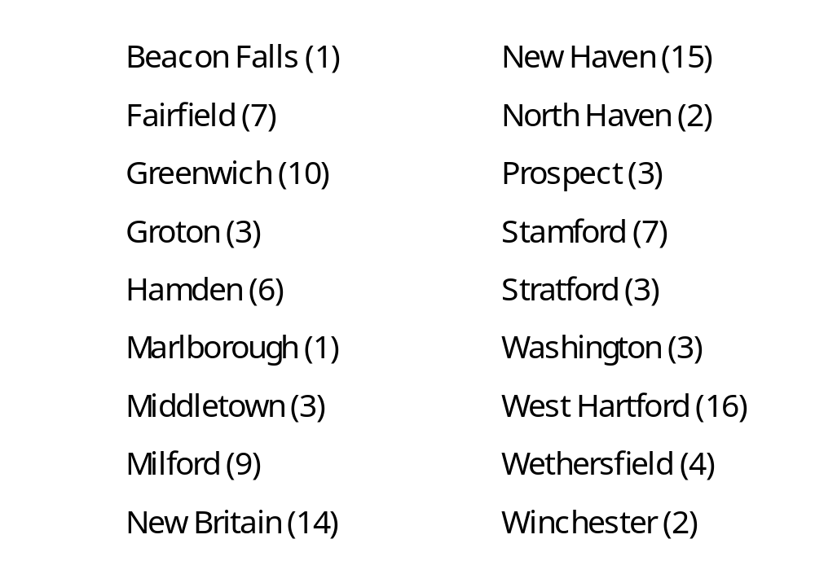
Approved Plans Are On the OSTA Website

Slide 12
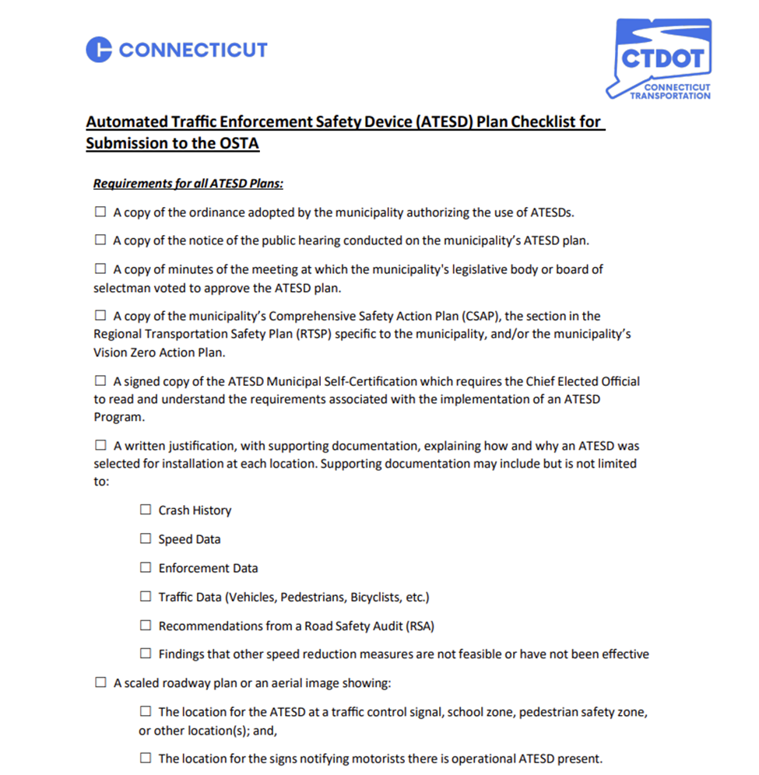
ATESD
Application
Checklist

Slide 13

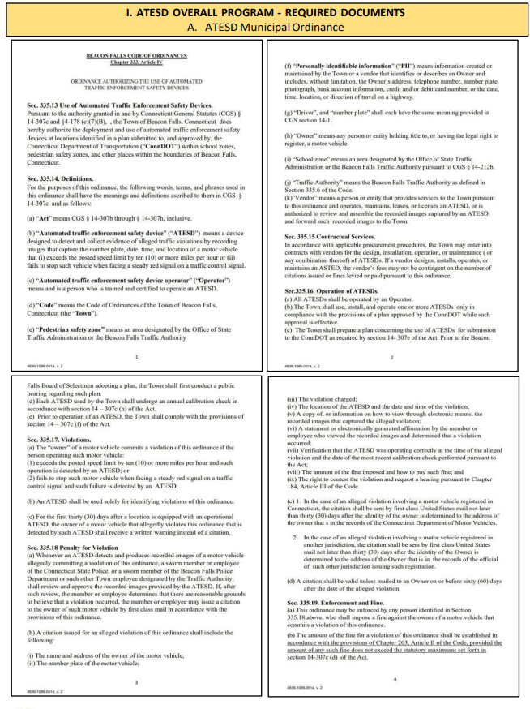
Checklist Item #1
Pass
the
Town
Ordinance

Slide 14
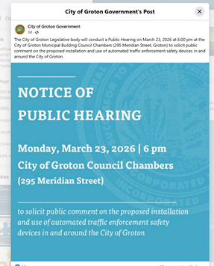
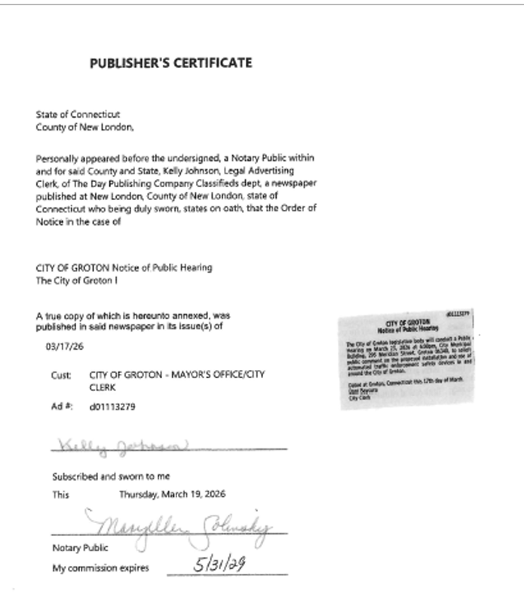
Checklist Item #2
Provide
Notice of
Public
Hearing for the
Town
Meeting

Slide 15
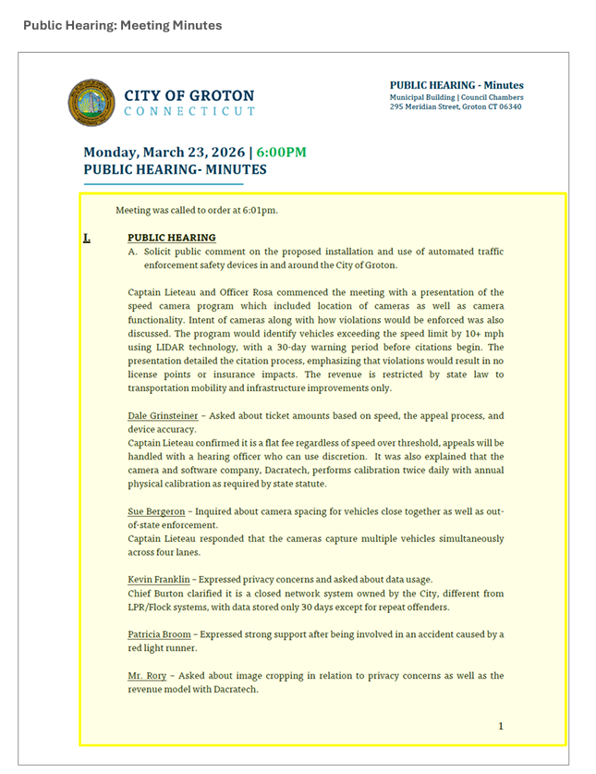
Checklist Item #3
Provide
Town
Meeting
Minutes

Slide 16
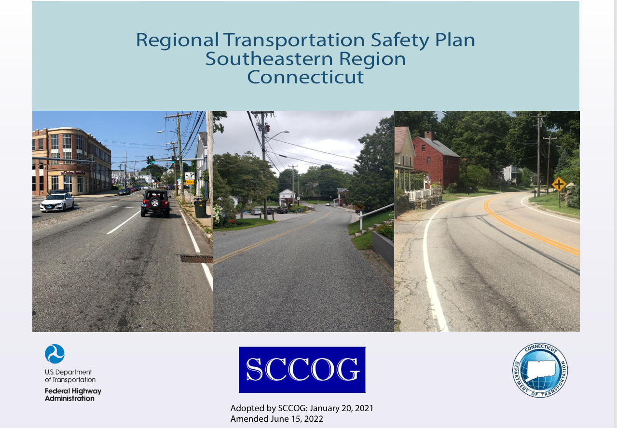

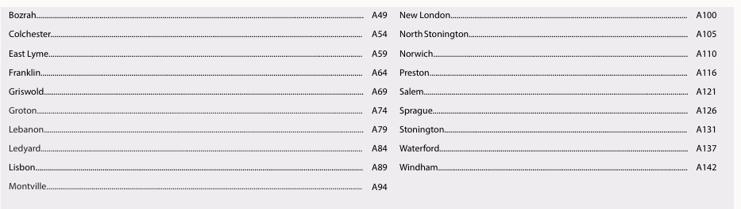
Checklist Item #4
CSAP
or
RTSP (Town Specific)
and/or
Vision Zero Plan

Slide 17
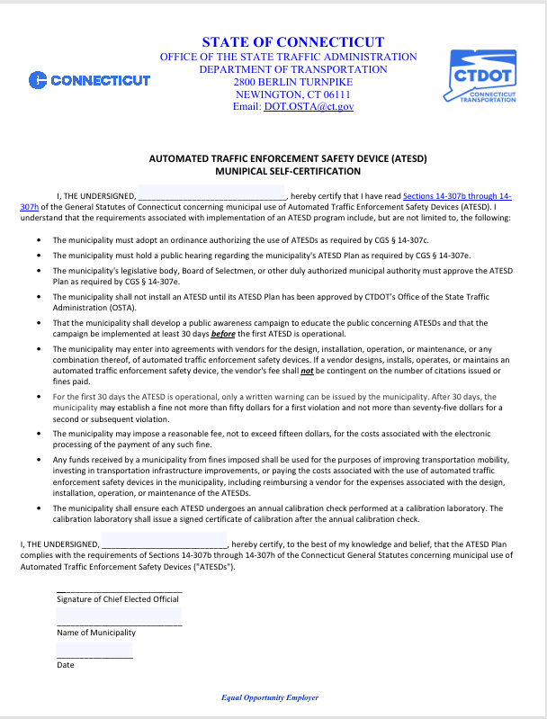
Checklist Item #5
ATESD
Self
Certification

Slide 18
Checklist Item #6
Crash History
Speed Data – 50th and 85th Percentile Speed
Enforcement Data
Traffic Data (ADT)
RSA Recommendations
ATESD
Location
Justification
Data Must Be Within Three Years and 0.5 Mile From Site

Slide 19
Checklist Item #6 (cont.)
Ineffective Speed Reduction Measures
Qualified Census Tract
School Zones
Pedestrian Safety Zones
ATESD
Location
Justification

Slide 20
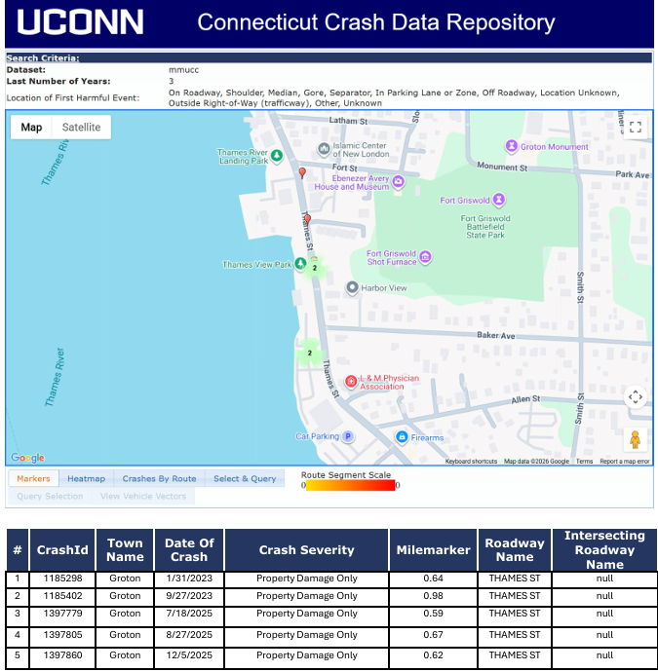
Crash
History

Slide 21
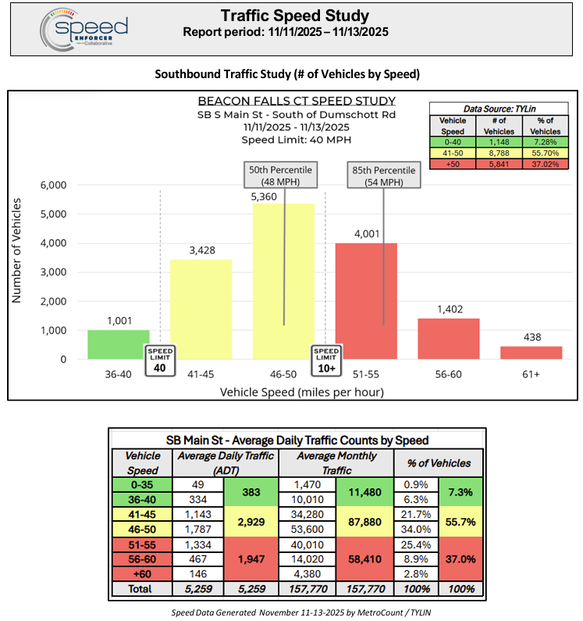
Speed Data

Slide 22
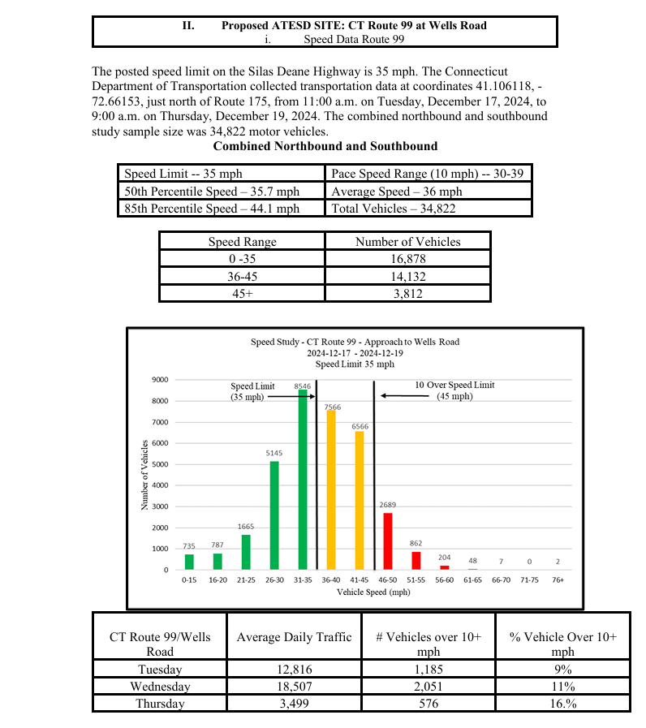
More
Speed Data

Slide 23
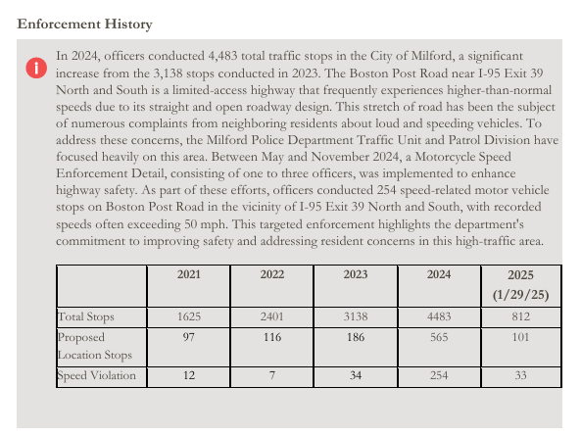
Enforcement Data

Slide 24
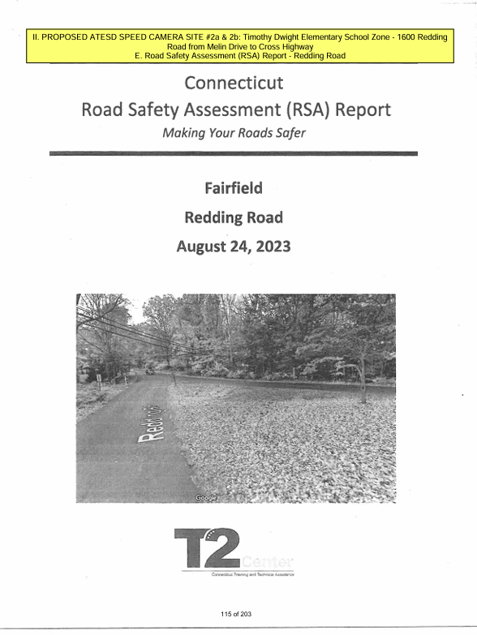
Road
Safety
Assessment
(RSA)
Recommendations

Slide 25
Qualified
Census
Tract
6 of 16 Towns in this COG Have QCT
No More than Two ATESDs in a QCT
No ATESDs on a Road in a Neighboring Town to Leads to a QCT

Slide 26
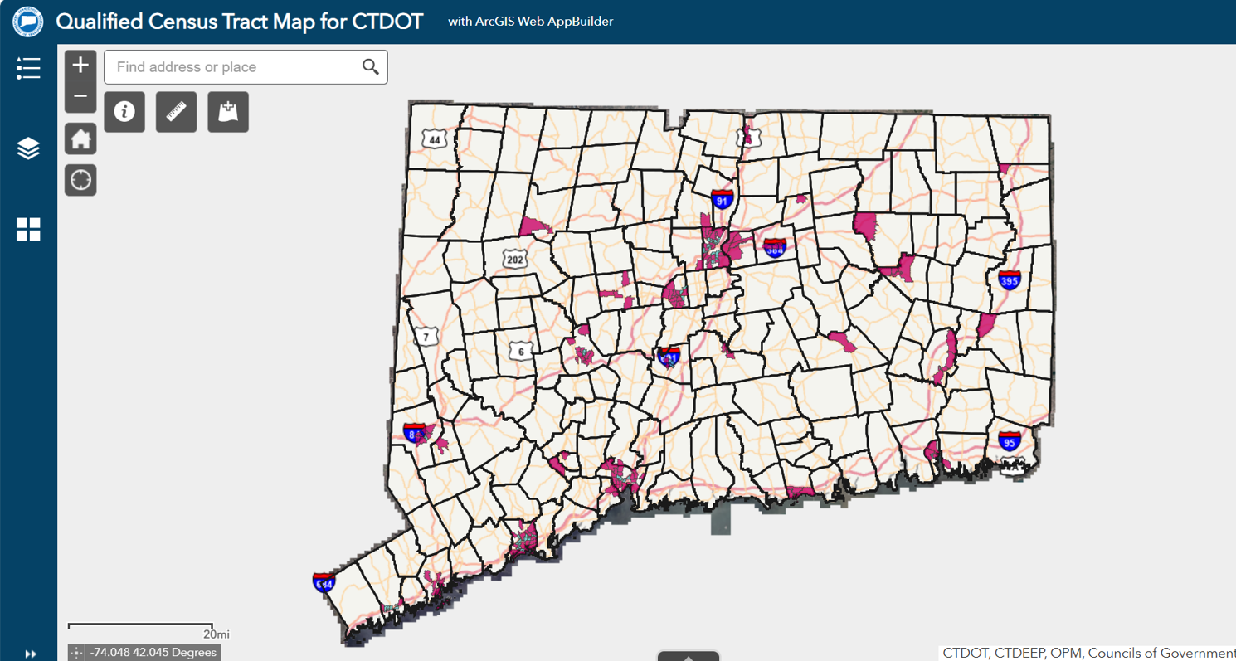
Qualified Census Tract Map
Once Equipment is Deployed, 30 Days of Warnings
First Offense - $50 + $15 Maximum Admin Fee That Vendor Keeps
Second and Subsequent Offenses - $75 + $15 Admin Fee
Each Ticket is Reviewed By Vendor and ANY Municipal Employee
There is an Appeal Process
No Points Against License
No Reporting to Insurance Companies

Slide 27
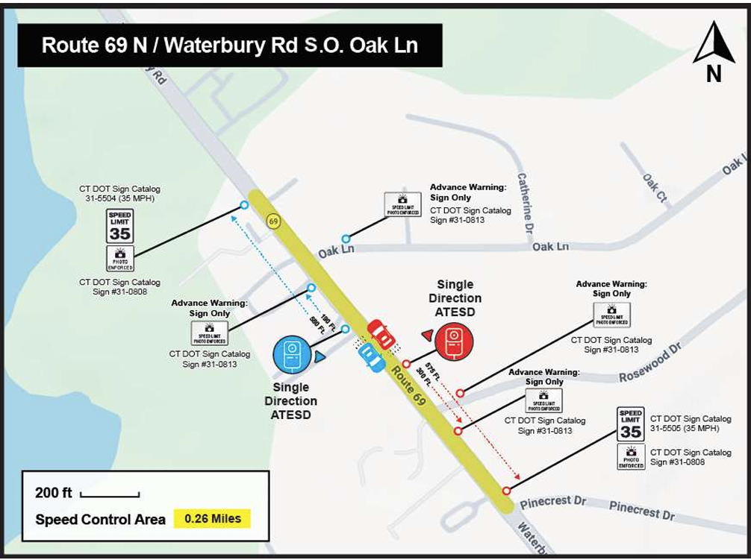
Scaled Roadway Plan or Aerial Image

Slide 28
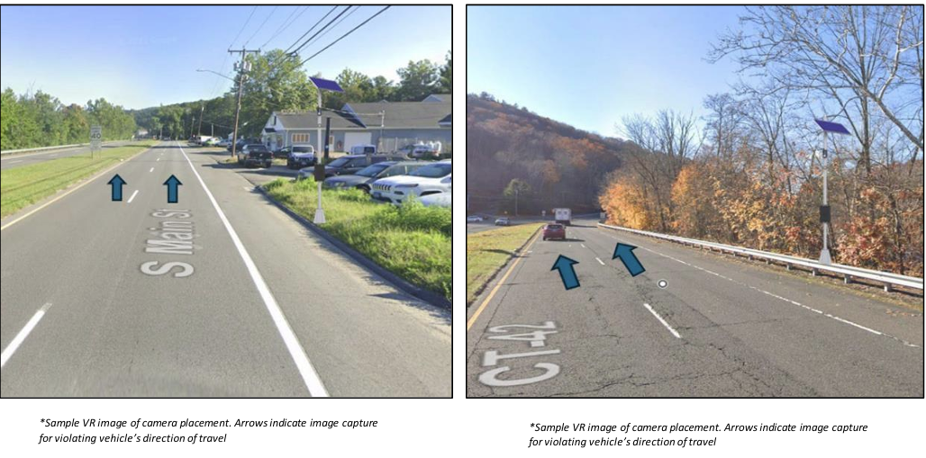
Scaled Roadway Plan or Aerial Image

Slide 29
OSTA Timelines
OSTA will Review to Ensure all Required Elements Were Included
If Not, You Will Be Notified in Writing of Missing Elements
After Complete Plan is Received, OSTA Has 60 Days to Review
Submit
Your
Plan!

Slide 30
OSTA
Will
Determine
If the ATESD plan is likely to improve traffic safety at the proposed location(s) and
If the ATESD distribution throughout the municipality is equitable.

Slide 31
OSTA Timelines
The Plan is Good For Three Years After the First Device Becomes Operational
Municipality Must Notify OSTA Within 14 Days of First Device Becoming Operational
You Must Notify Navigational Apps
After
Your
Plan
Has Been
Approved

Slide 32
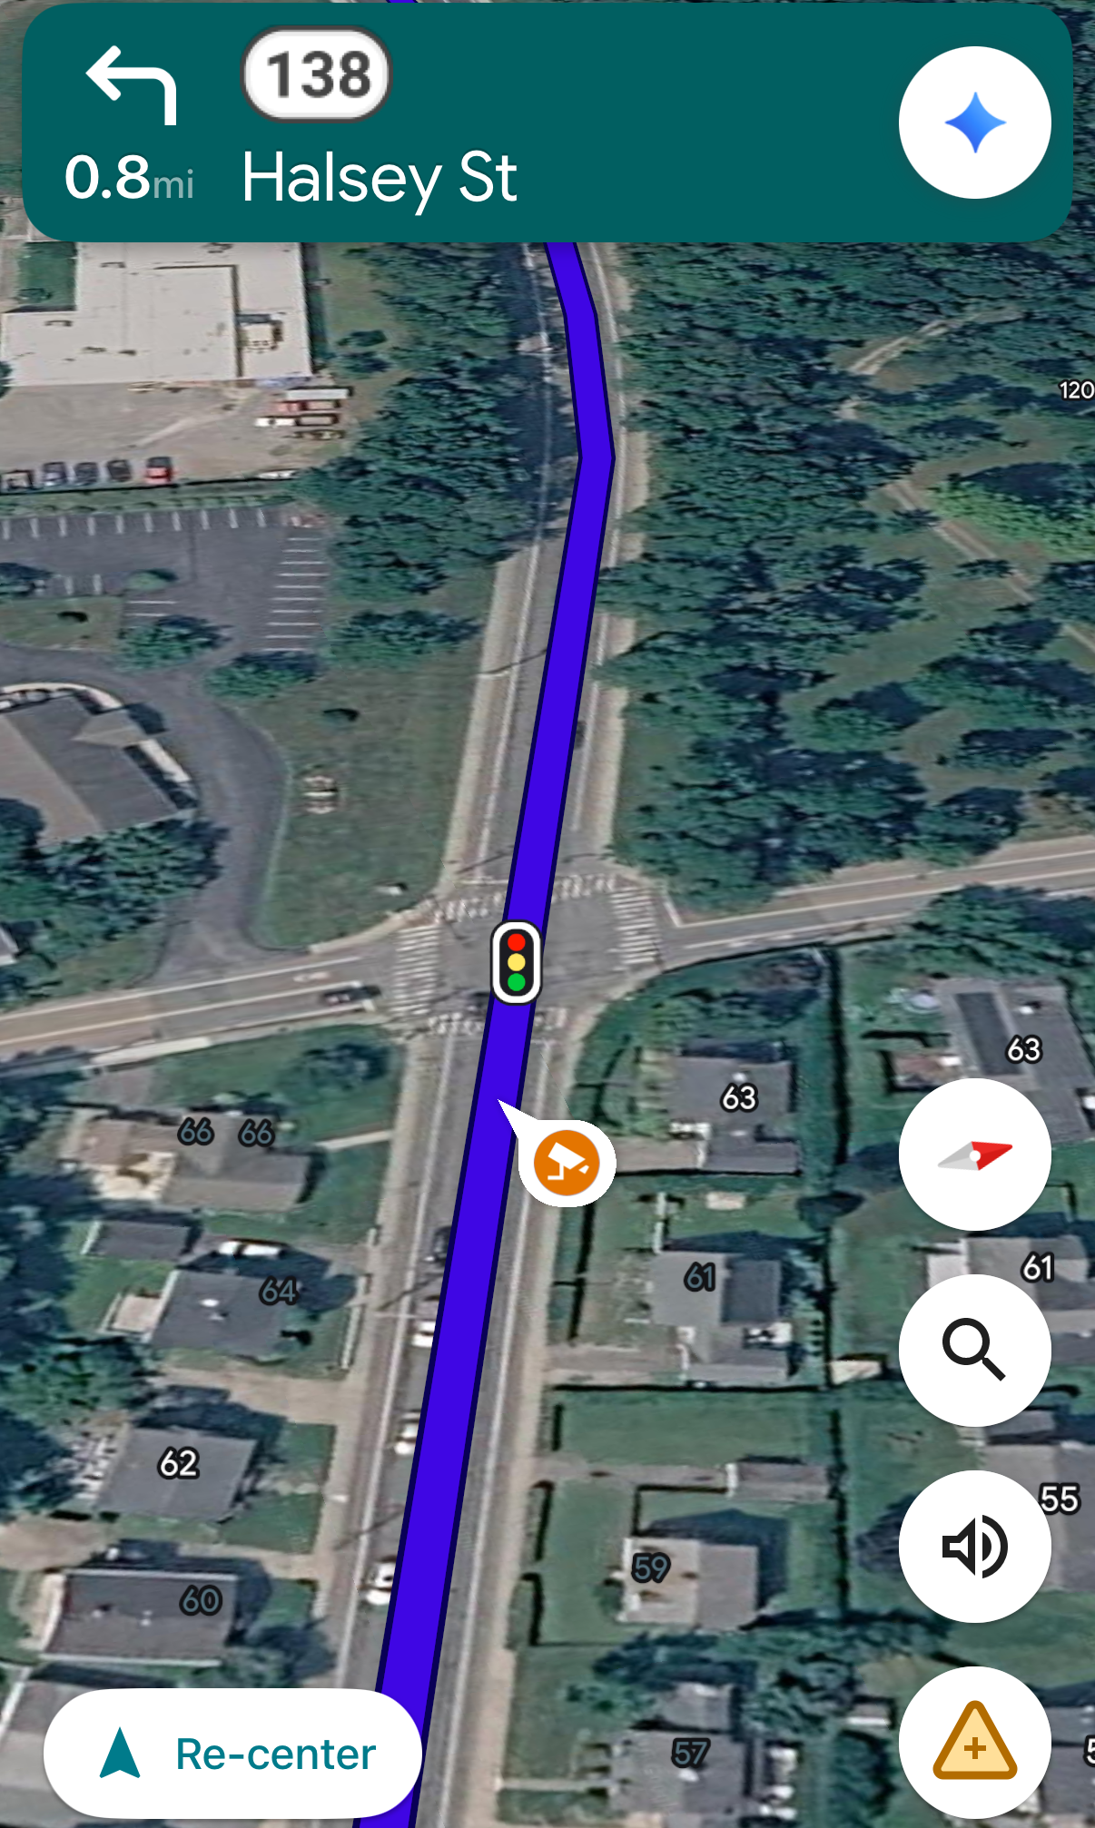
Speed
Camera
Location on
Google Maps

Slide 33

Potential Pitfalls

Slide 34
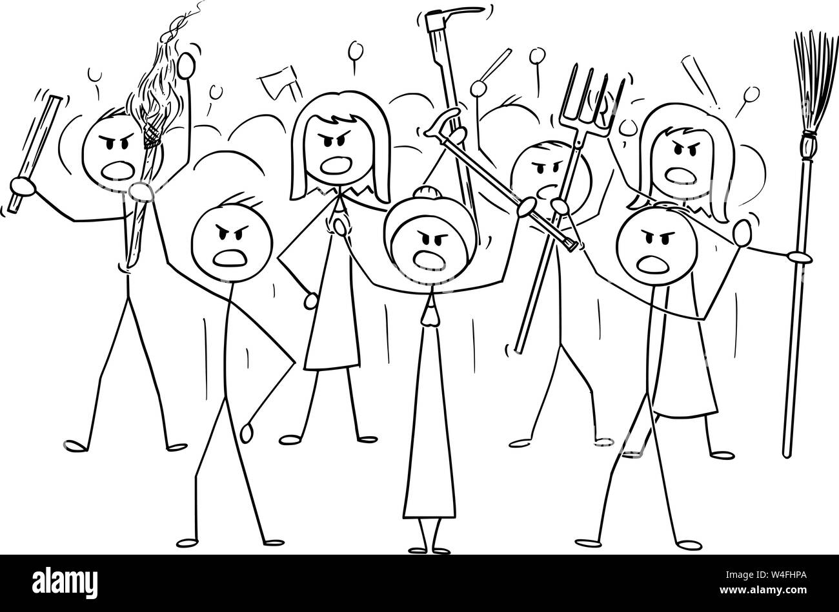
Potential Pitfalls

Slide 35
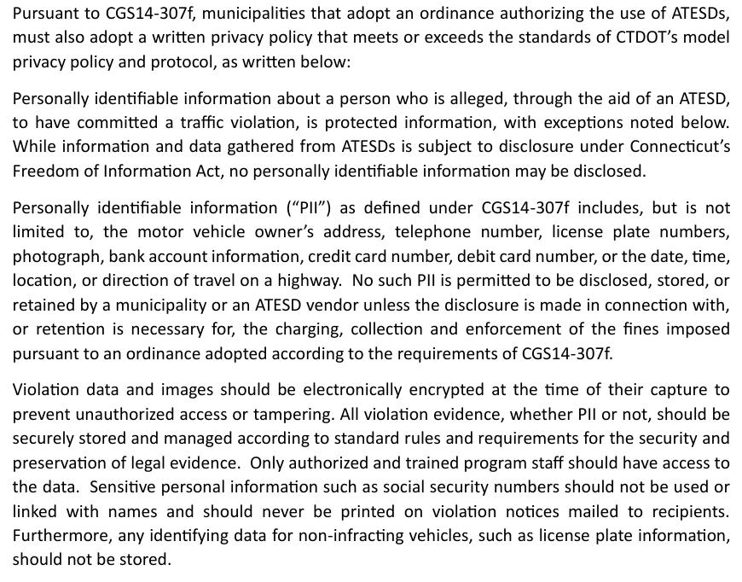
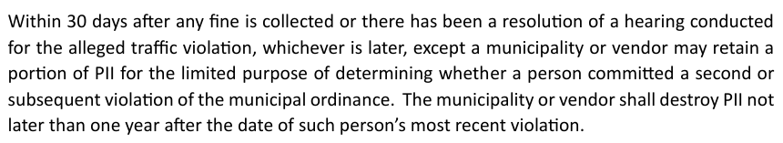
You Must
Adopt a
Privacy
Policy

Slide 36
ATESD vs FLOCK
Only Captures Violations Records Each Vehicle
Records Plate and Metadata Records Vehicle ID’s and Metadata
Data is subject to FOI, but Personal Governed by POST Gen. Notice
Identifying Information May 26-01
NOT be Disclosed P.A. 26-14 Goes in to Effect 10/1
BOTH: Timelines for Data Erasure in Statute - 30 Days

Slide 37
What is
Personal
Identifying
Information?
Address
Phone Number
Plate
Photograph
Bank, Credit Card or Debit Card Information
Date, Time, Location or Direction of Travel

Slide 38
PII Storage and Retention
Can’t Keep Data Unless it’s Related to a Ticket
30 Days After Resolution – Data Must Be Destroyed Except Small Amount to Verify if a Second Offense Was Committed
All Data Must be Destroyed Not Later Than One Year After the Most Recent Violation

Slide 39
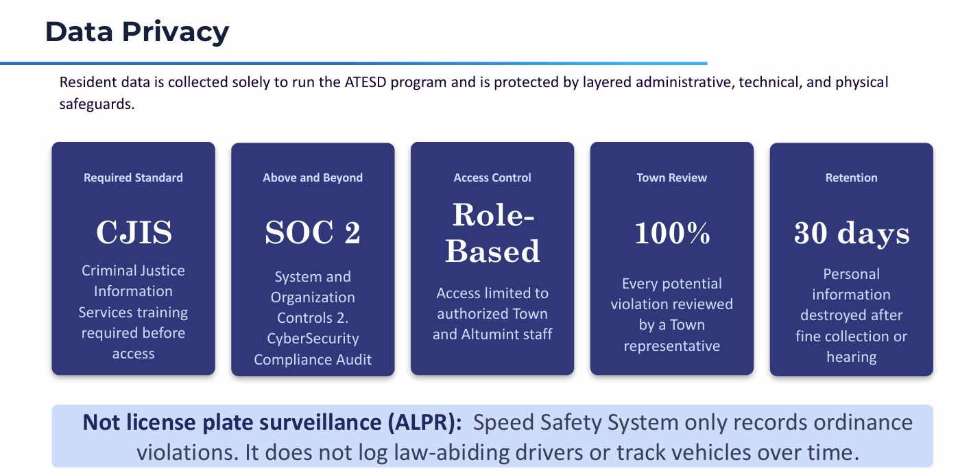
Fairfield’s Town Website

Slide 40
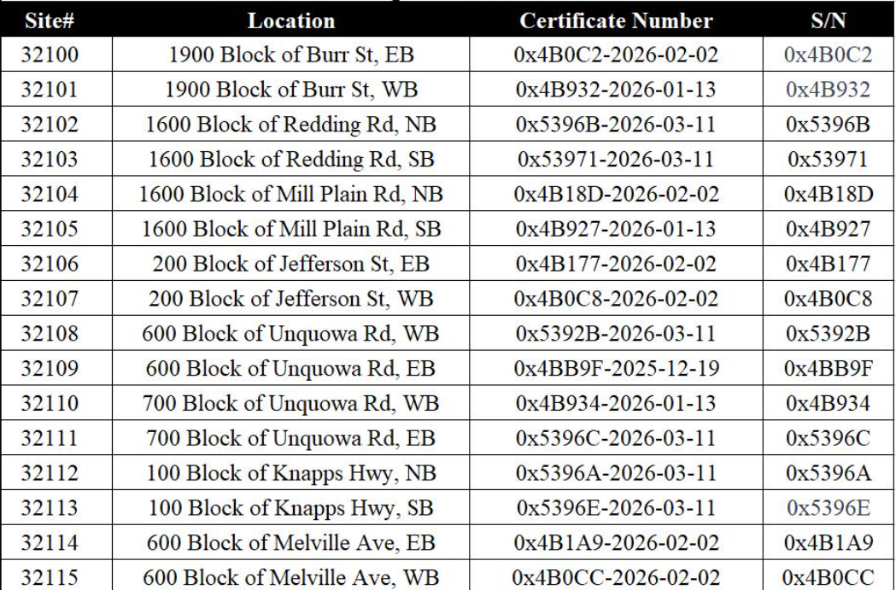
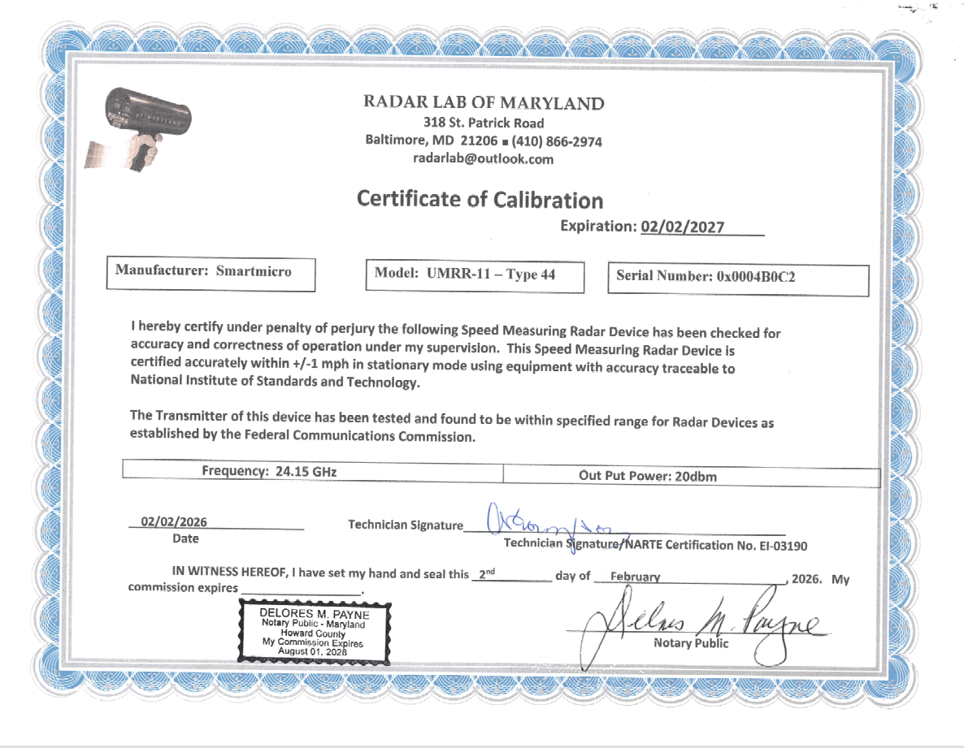
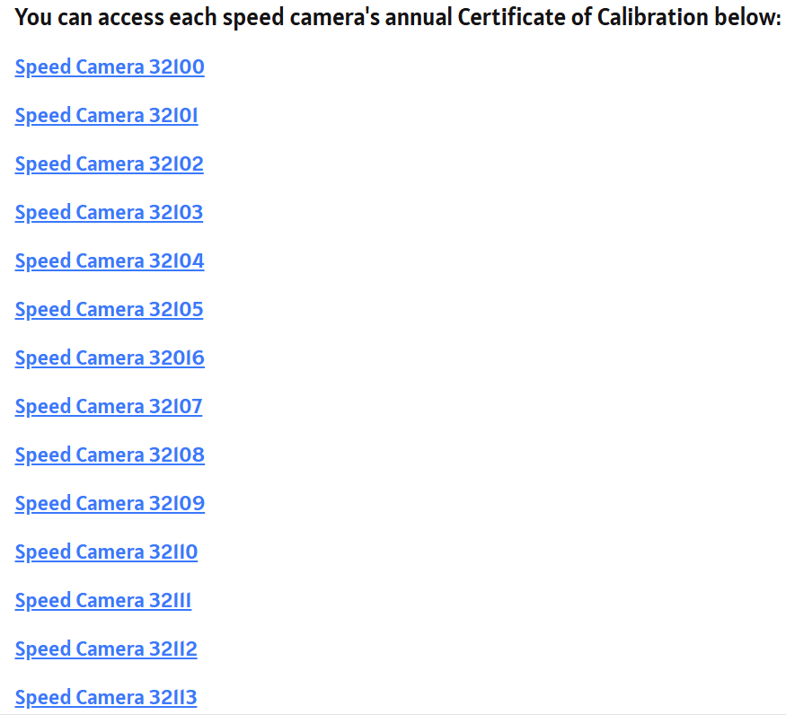
Calibration Transparency:
Fairfield’s
Town
Webpage

Slide 41
More Pitfalls
Volume of Tickets
In-Person Payments
Where Does the Money Physically Go
Who Will Review Tickets
Appeals Process
Who Do People Contact
      Dedicated Voicemail
      Dedicated E-mail address

Slide 42
Defenses to Tickets
Emergency Vehicles
The Traffic Signal was Inoperative *
The Violation Occurred Because of a Direction by a Law Enforcement Officer *
The Violation was Necessary to Allow Passage of an Emergency Vehicle *
The Vehicle Had Been Stolen
The ATESD was Not in Compliance with the Calibration Check
*must be observable in images

Slide 43
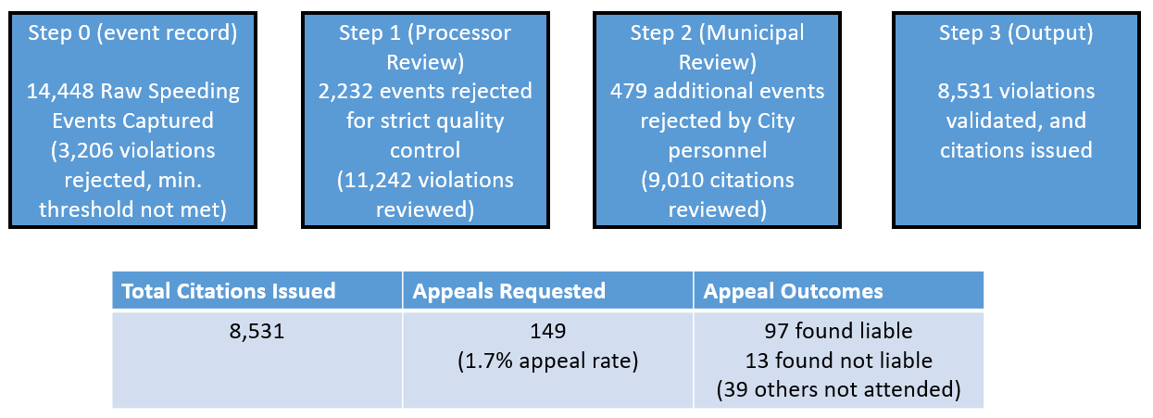
Middletown Validation and Appeals Process
5438 x $15 = -$81,570 in Fees
479 x $50 = -$23,950 in Citations

Slide 44



What To Do With the Money?
By Statute
C.G.S. 14-307c(d)(2) - Any funds received by a municipality from fines imposed pursuant to an ordinance adopted under this section shall be used for the purposes of improving transportation mobility, investing in transportation infrastructure improvements or paying the costs associated with the use of automated traffic enforcement safety devices in the municipality.

Slide 45

Is It Working?

Slide 46
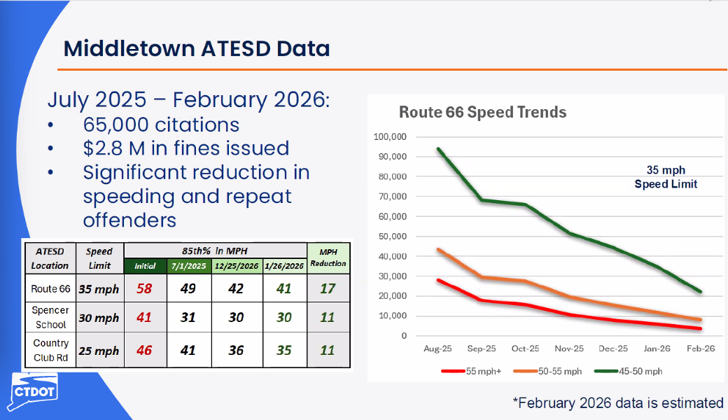

Slide 47
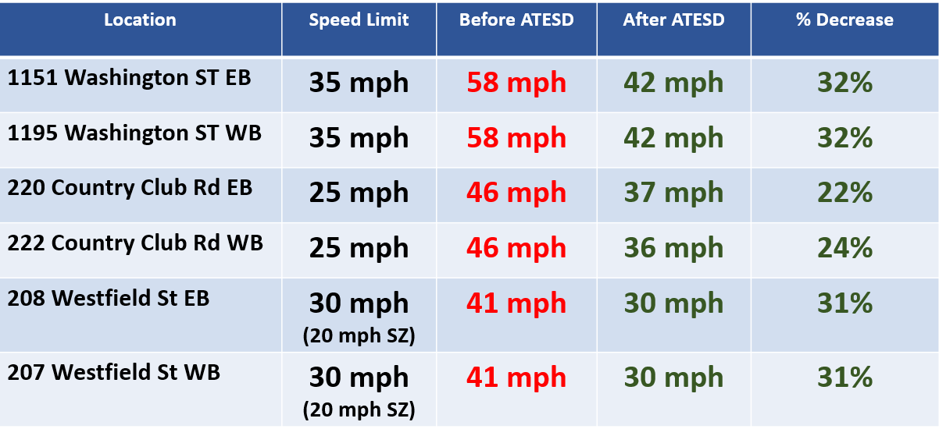
Middletown Reduction in 85th Percentile Speeds

Slide 48
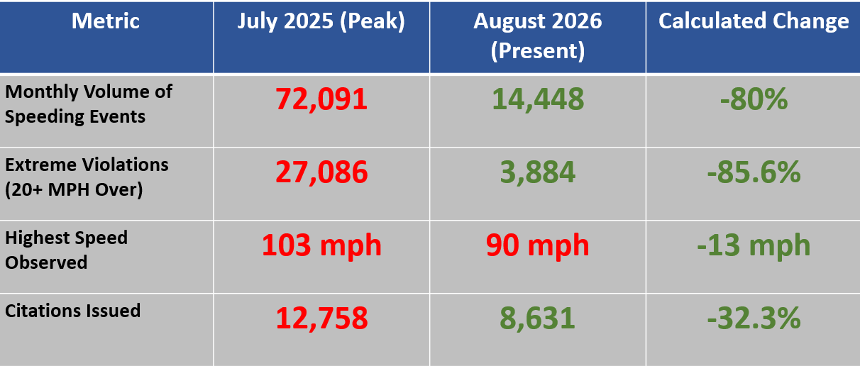
Middletown Volume and Violations Metrics

Slide 49
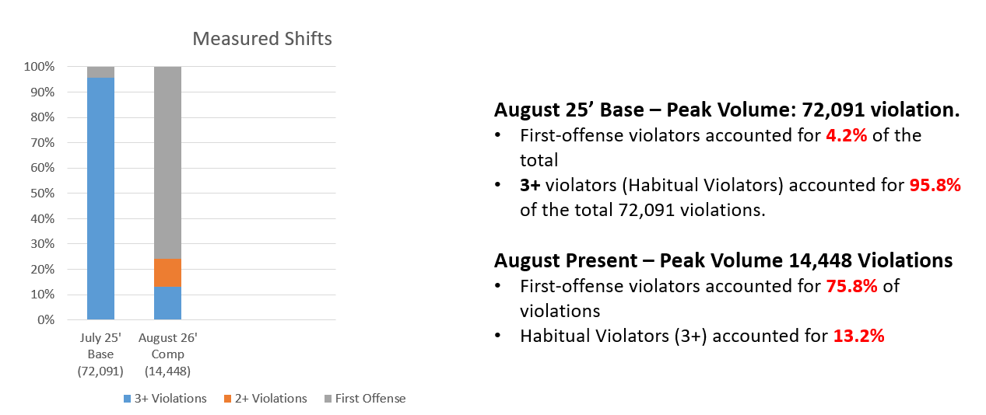
Middletown Violator Frequency

Slide 50
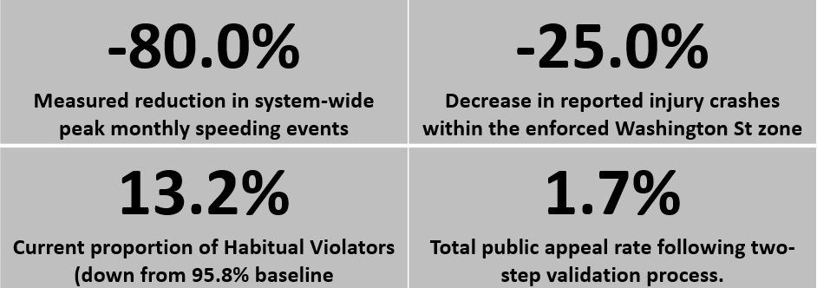
Middletown Summary

Slide 51
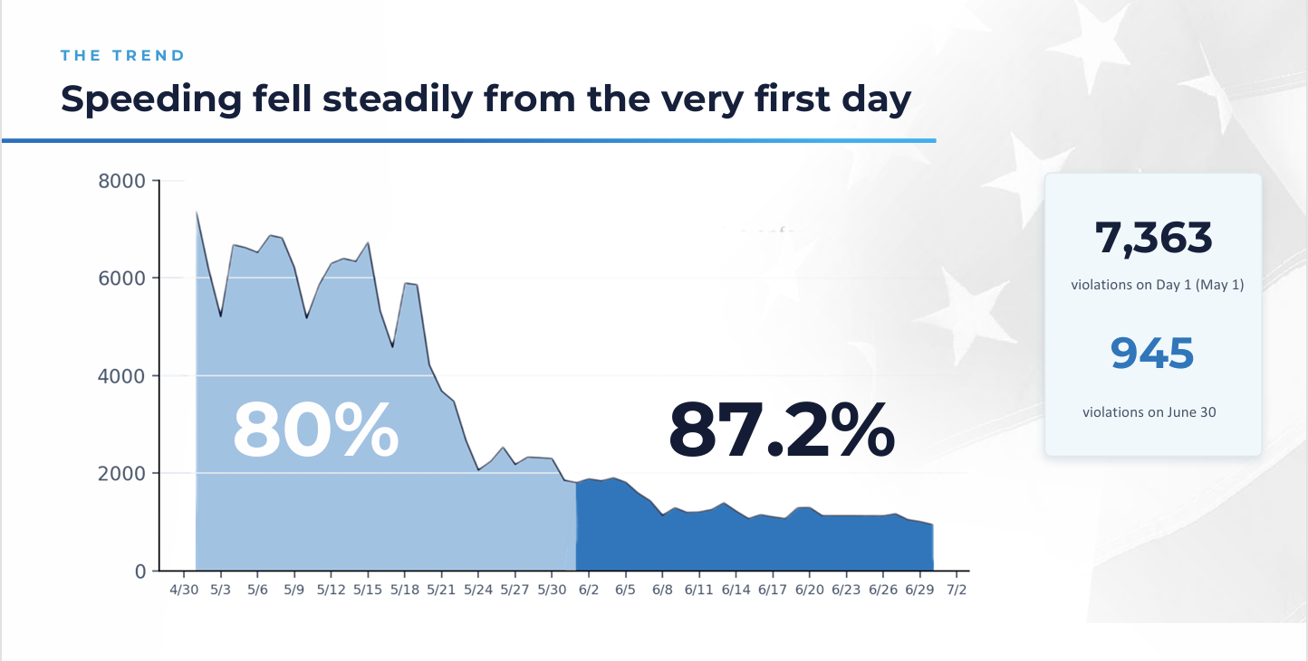
Warning vs Enforcement Period – Fairfield

Slide 52


